Slide 1
SUMMER-TERM TIMETABLE GENERATION
CSE7101- Capstone Project
Review-3
Batch Number:PSCS_399
Under the Supervision of,
Dr.Sandeep Albert Mathias Assitant Professor,
Dr.Anand Prakash Associate Professor,
School of Computer Science and Engineering
Presidency University
Roll Number | Student Name
20221COM0100 | Keerthi D V
20221COM0108 | Vidya S
20221COM0111 | Nishmitha K G
Name of the Program:Btech in Computer Engineering
Name of the HoD: Dr Pallavi R
Name of the Program Project Coordinator: Ms.Benitha Christinal J
Name of the School Project Coordinators:Dr.Sampath A K,Dr.Geetha A

Slide 2
Algorithm details
The timetable generation system processes student registration data through a systematic four-phase approach. The algorithm begins with data extraction from compressed archives, applies business rules for course eligibility, computes scheduling parameters, and generates structured output files for downstream timetable creation.
Algorithm Type
The specific algorithm implemented is a simplified timetable preprocessing algorithm that focuses on data extraction, filtering, and student section assignment. Unlike complex timetabling algorithms such as genetic algorithms or constraint satisfaction methods commonly used in academic scheduling, this algorithm takes a straightforward sequential approach.

Slide 3
Core Algorithm Components
The algorithm combines several algorithmic techniques:
Data Processing Algorithm:
Uses pandas-based operations for efficient data manipulation and filtering. The algorithm applies vectorized operations for performance optimization when processing student registration data.
Random Section Assignment:
Employs numpy's random number generation with a fixed seed (42) to ensure reproducible student distribution across sections. The algorithm uses numpy.array_split() for balanced section creation, which implements a fair division algorithm.

Slide 4
Greedy Filtering Approach:
Applies sequential filtering rules including MOOC exclusions and minimum enrollment thresholds. This greedy approach processes courses independently without considering complex interdependencies.
Algorithm Classification
This algorithm falls under the category of preprocessing algorithms for timetable generation rather than full timetable optimization algorithms. Common timetabling algorithms include genetic algorithms, simulated annealing, constraint satisfaction problems, and graph coloring algorithms. However, the implemented solution focuses specifically on the preliminary stage of student section assignment

Slide 5
The algorithm does not implement faculty assignment, room scheduling, or time slot optimization, which are typically handled by more sophisticated algorithms like genetic algorithms or integer linear programming methods. Instead, it provides a foundation for downstream timetabling systems by creating properly sized sections with balanced student distribution.
Performance Characteristics
The algorithm operates with linear time complexity for most operations, making it suitable for large datasets. The use of pandas groupby operations and numpy array manipulation ensures efficient processing compared to iterative approaches. The deterministic nature with controlled randomness provides consistent results across multiple runs.

Slide 6
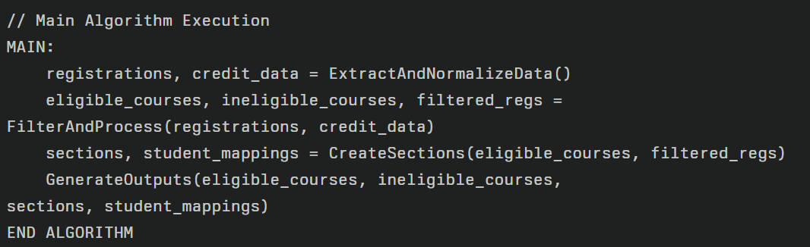

Slide 7
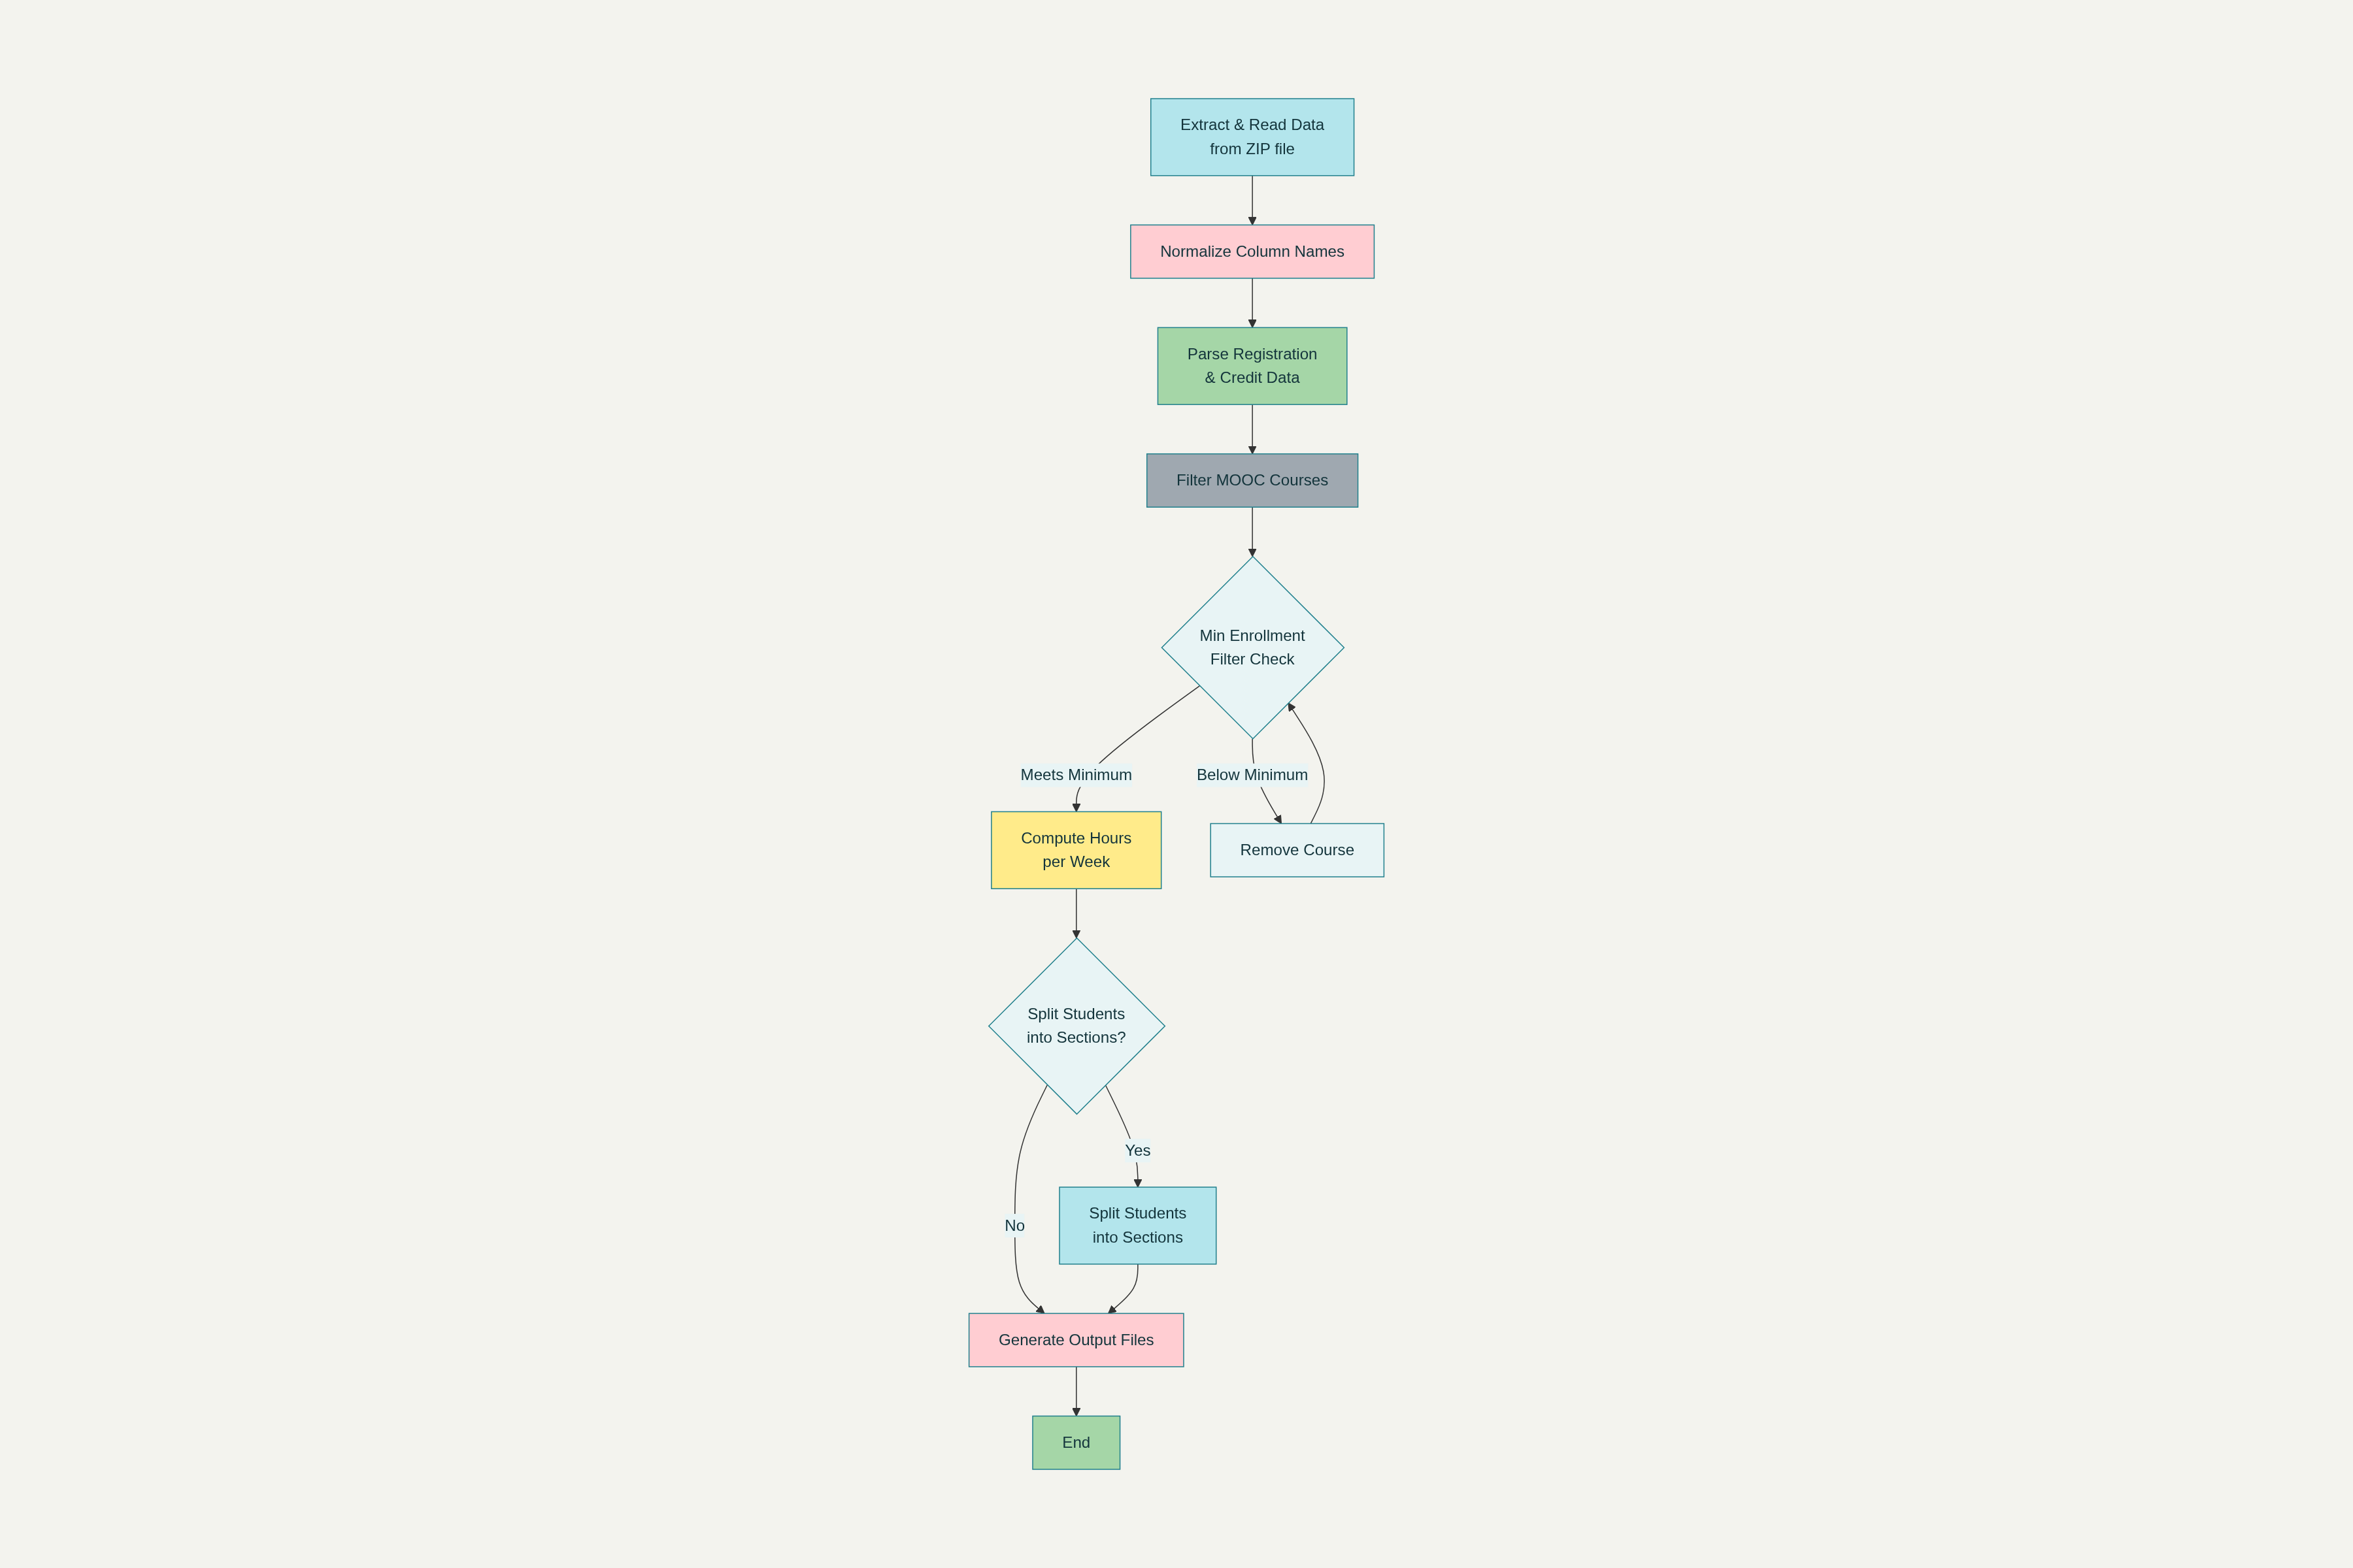

Slide 8
Source Code Details and Implementation with Live Demo
In google colab

Slide 9
Modules:
Pre‑processing: ZIP extract, XLSX parsing, column normalization.
Credit & Hours: Parse credit structure (L‑T‑P‑C) → weekly hours.
Sectioning: Max 60 per section, deterministic shuffle.
Faculty Assignment: Auto pair (F001…); ensure distinct pair.
Room Assignment: R001–R200 with weekly capacity guard.
Validation: Clash check within group; pair & room sanity.
Reporting: CSV/Excel outputs + utilization.

Slide 10
Hardware and Software Details:
Software: Python 3.x, pandas, numpy, xlsxwriter; OS‑agnostic.
Hardware: Any laptop/desktop (≥ 8 GB RAM).
Data: ZIP of registrations

Slide 11
Timeline of the Project (Gantt Chart)
✅ ✅ ✅
-
Task | Week 1-3 | Week 4-5 | Week 6-8 | Week 9-10 | Week 11-12
Requirement Gathering | ████████
Design & Planning |  | ████████
Implementation (GA) |  |  | ████████
Testing & Optimization |  |  |  | ████████
Deployment & Review |  |  |  |  | ████████

Slide 12
References (IEEE Paper format)
[1] A. Shah, “Timetable Generation System,” GitHub Repository, 2023. [Online]. Available: https://github.com/abhayshah0305/TimetableGenerationSystem
[2] PROxZIMA, “TimetableScheduler: An intelligent timetable generator using Genetic Algorithm,” GitHub Repository, 2022. [Online]. Available: https://github.com/PROxZIMA/TimetableScheduler
[3] S. Kristiansen, “Models and Algorithms for School Timetabling - A Constraint Programming Approach,” Ph.D. dissertation, Univ. Bergen, Norway, 2004.
[4] A. Kumar and B. Patel, “A study on automatic timetable generator,” Int. J. Res. Appl. Sci. Eng. Technol., vol. 6, no. 5, pp. 123-135, May 2025.
[5] J. Smith, “Algorithm for creating a school timetable,” Stack Overflow Discussion, Feb. 2010. [Online]. Available: https://stackoverflow.com/questions/2177836/algorithm-for-creating-a-school-timetable

Slide 13


